Slide 1
Spring Core Tutorial

Slide 2
Agenda
Introduction to Spring
Spring Modules
Spring Core Container
Beans Wiring and Life-cycle
Auto-wiring

Slide 3
Introduction to Spring

Slide 4
What is Spring?
Spring is a lightweight dependency injection and aspect-oriented container and framework.
Spring characteristics:
  Lightweight – Bulk of Spring framework can be distributed into a single JAR file of size equal to almost 2.5 MB.
  Dependency Injection (DI) – Spring framework promotes loose coupling using this technique. Objects are given dependencies (other objects) instead of creating or looking for dependent objects for themselves.
  Aspect-oriented programming (AOP) – Spring framework enables cohesive development by separating application business logic from system services, like auditing and transaction management. Application objects perform the business logic only; they are not responsible for other system concerns such as logging or transactional support.

Slide 5
What is Spring (contd.)?
Spring characteristics:
  Container – Spring is a container in the sense that it contains and manages the lifecycle and configuration of application objects. You can declare how each of your application objects should be created, how they should be configured, and how they should be associated with each other.
  Framework - Spring makes it possible to configure and compose complex applications from simpler components. Spring also provides much infrastructure functionality like transaction management, integration with persistence frameworks, etc., thereby leaving only the application logic to you.
Spring is not just this. It comes with several modules that are built on the foundation of DI and AOP to create enterprise applications.

Slide 6
Spring Modules

Slide 7
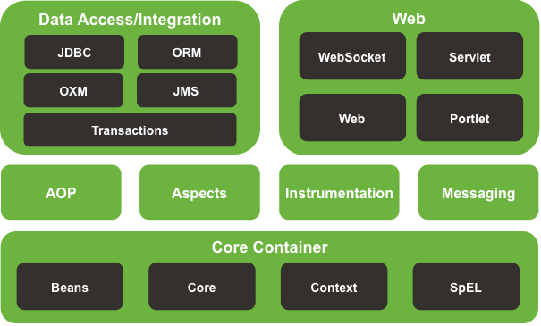
Spring modules
You are free to choose the Spring modules that suit your application and look to other options when Spring doesn’t fit the bill. In fact, Spring offers integration points with several other frameworks and libraries so you won’t have to write them yourself.
The Spring framework consists of features organized in about 20 modules. These modules are grouped into Core Container, Data Access/Integration, Web, AOP, Instrumentation, and Messaging.

Slide 8
Important Spring modules listing
Core container - All spring modules are built on top of the core container. The core container defines how beans are created, configured, and managed. This module contains BeanFactory, which is the fundamental of DI.
Application context – It is built on top of the core container, and makes Spring a framework. Adds support for resource loading, events’ propagation, and internationalization using resource bundles, etc. This is provided by ApplicationContext.
Aspect-oriented programming (AOP) – With AOP, application-wide concerns such as transactions, security, logging, etc. are decoupled from the spring objects to which they are applied.
JDBC abstraction and DAO – Provides a JDBC abstraction layer that removes the need to do boilerplate JDBC coding and parsing of database-vendor specific error codes. In addition, this module uses Spring’s AOP module to provide transaction management for Spring objects.

Slide 9
Important Spring modules listing (contd.)
ORM integration - Spring doesn’t attempt to implement its own ORM solution, but does provide hooks into several popular ORM frameworks, including Hibernate, Java Persistence API (JPA), etc.
Spring MVC – The Model-View-Controller (MVC) paradigm is a common approach in building web applications so that the user interface (UI) is separate from business logic. Spring comes with its own MVC framework that promotes loosely-coupled techniques in the web layer of an application.
Spring Web – Provides initialization of Spring container to have a web-oriented application context. It also provides integration with legacy MVC frameworks like Struts, Java Server Faces (JSF), Struts 2.0, etc.
Java Messaging Service (JMS) - Message-oriented communication guarantees delivery of messages, even if network fails. Spring’s Java Message Service (JMS) module helps you send messages to JMS message queues. Also, this module helps you to create message-driven POJOs that are capable of consuming asynchronous messages.

Slide 10
Spring Core Container

Slide 11
BeanFactory and ApplicationContext
A BeanFactory pretty much just instantiates and configures beans. An ApplicationContext also does that, and it provides the supporting infrastructure to enable lots of enterprise-specific features such as transactions and AOP.
BeanFactory factory = new XMLBeanFactory(
new ClassPathResource("beans.xml"));
ApplicationContext context =
new ClassPathXmlApplicationContext("beans.xml"));
beans.xml
<bean id="aUniqueId" class="com.ttnd.bootcamp.pojo.Employee" />
There is another major difference between the two. A bean factory lazily loads all the beans, deferring bean creation until the getBean() method is called. An application context preloads all the singleton beans upon context startup.

Slide 12
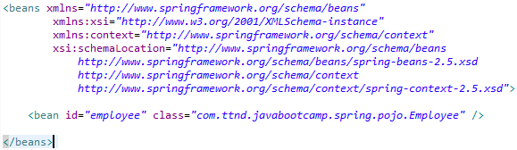
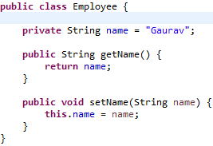
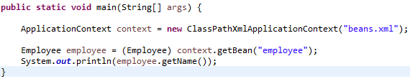
ApplicationContext example

Slide 13
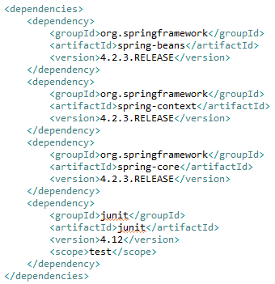
Downloading Spring
Using Maven, we will configure all the necessary JARs in order to download and install Spring.
Dependencies:

Slide 14
Importing Bean Definitions
In a large application, it is generally convenient to place bean definitions in separate XML files, maybe grouped by the module.
For example, an e-commerce application can have bean definitions of products in one file, orders in another file, and customers in a third one.
This can be achieved using <import resource=“…” /> element.
beans.xml
<beans . . . .
. . . . . . . . . >
<import resource=“orders-beans.xml” />
<import resource=“customers-beans.xml” />
<!-- Bean definitions related to products -->
</beans>

Slide 15
Beans Wiring and
Life-cycle

Slide 16

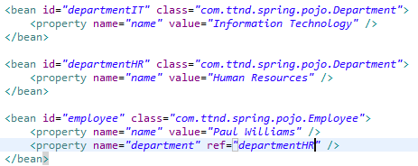
Bean wiring – Setter injection
Setter injection is most often used to inject Spring beans or dependencies. Inside the <bean> tag, the <property> tag is used to inject dependencies.
The value attribute of <property> tag is used to inject simple values onto the dependencies. It can be used to inject String, numeric, or even boolean values.
The ref attribute of <property> tag is used to inject references to other Spring beans.

Slide 17
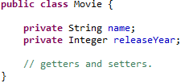
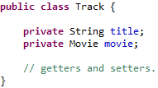
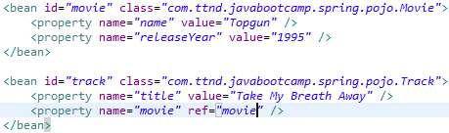
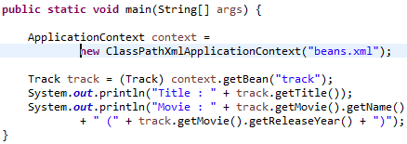
Bean wiring – Setter injection example
Setter injection is most often used to inject Spring beans or dependencies.

Slide 18

Bean wiring – Constructor injection
Constructor injection is another way of injecting dependencies.
Inside the <bean> tag, the <constructor-arg> tag can be used to create a bean and inject its dependencies using a parameterized constructor.
If default constructor is not provided, then the bean would always need to be initialized using one of its parameterized constructors.
index attribute of <constructor-arg> tag is used to specify the exact index of the argument in the constructor argument list. Only needed to avoid ambiguities, e.g. in case of 2 arguments of the exact same type.

Slide 19
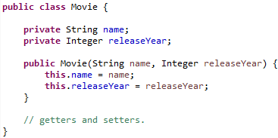
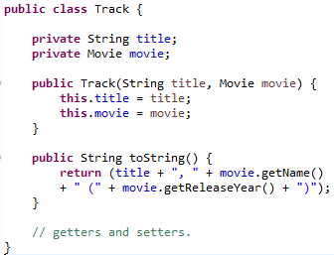
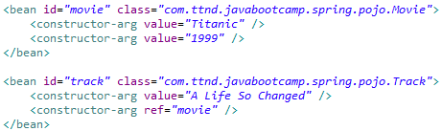
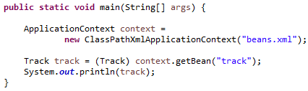
Bean wiring – Constructor injection example

Slide 20
Setter or Constructor Injection?
Constructor injection is more useful since:
  Constructor injection enforces strong dependency contract – a bean cannot be instantiated without given all of its dependencies.
  There’s no need of setter methods keeping lines of code less.
Setter injection is more useful since:
  If a bean has several dependencies, the constructor's parameter list can be quite lengthy.
  Does not break beans’ creation when new properties are added.
  Resolves circular dependencies - consider the scenario where you have class A, which requires an instance of class B to be provided via constructor injection, and class B, which requires an instance of class A to be provided via constructor injection. If you configure beans for classes A and B to be injected into each other, the Spring container will detect this circular reference at runtime, and throw an exception.
  To resolve these circular dependencies, setter-injection is the solution.

Slide 21
Bean life-cycle
A Spring bean has an entire life-cycle inside a Spring container. The most important stages of a Spring-managed bean are as follows:
Instantiate – Spring container instantiates the bean.
Populate properties – Spring injects the bean’s properties through setter and/or constructor injection.
Set bean name – If the bean implements BeanNameAware interface, then the bean’s setBeanName() method is invoked, wherein Spring passes the bean’s ID as the method argument.
Set bean factory – If the bean implements BeanFactoryAware interface, then the bean’s setBeanFactory() method is invoked, wherein Spring passes the bean factory as the method argument.
Before initialization post-processors – If there are any BeanPostProcessors, their postProcessBeforeInitialization() method is invoked.

Slide 22
Bean life-cycle (contd.)
Initialize beans – If the bean implements InitializingBean interface, then its afterPropertiesSet() method is invoked. If the bean has a custom init-method declared in the configuration file, then the specified initializing method would also be invoked.
After initialization post-processors – If there are any BeanPostProcessors, their postProcessAfterInitialization() method is invoked.
Bean is ready to use – At this point, the bean is ready to be used by the application and will remain in the bean factory until it is no longer needed.
Destroy bean - If the bean implements DisposableBean interface, then its destroy() method is invoked. If the bean has a custom destroy-method declared in the configuration file, then the specified initializing method would also be invoked.

Slide 23
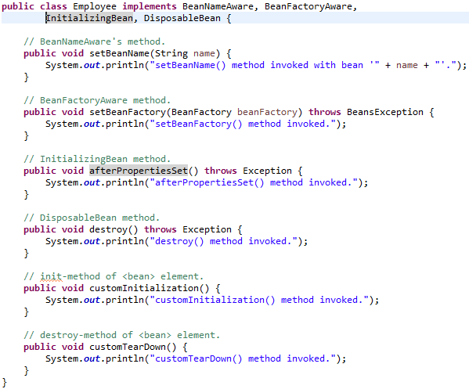
Bean life-cycle illustration

Slide 24
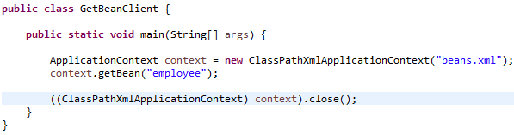
Bean life-cycle illustration (contd.)
Output
setBeanName() method invoked with bean 'employee'.
setBeanFactory() method invoked.
afterPropertiesSet() method invoked.
customInitialization() method invoked.
destroy() method invoked.
customTearDown() method invoked.

Slide 25

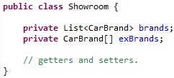
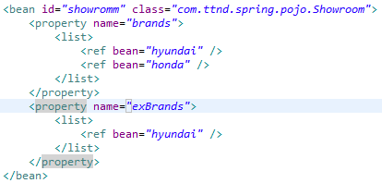
Wiring Collections
<list> element is used with properties that are of any implementation of java.util.Collection or an array. To ensure unique elements, <set> element is used.

Slide 26

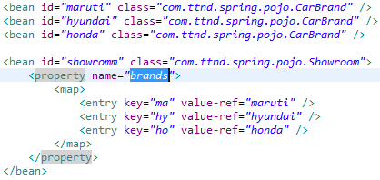
Wiring Maps
<map> element is used to configure name-value pairs, corresponding to java.util.Map.

Slide 27

Wiring null
Nothing (or null) can be wired using <null /> tag as follows:

Slide 28
Auto-wiring

Slide 29
Auto-wiring
In a large application, sometimes wiring explicitly using <property> element (setter injection) or <constructor-arg> element (constructor injection) can result in lot of XML.
Rather than explicitly wiring all of your bean’s properties, you can configure Spring to automatically figure out how to wire beans together by setting the autowire property on each <bean> that you want Spring to autowire.
There are four flavors of autowiring:
  byName
  byType
  constructor
  autodetect

Slide 30
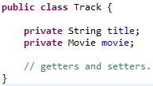
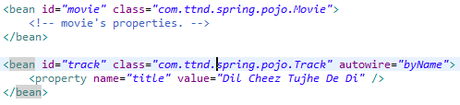
Auto-wiring by name
If the name of a property happens to match the name of the bean that is to be wired into that property, then Spring automatically wires it.
If no matching bean of same ID (or name) is not found, the property will remain unwired.

Slide 31
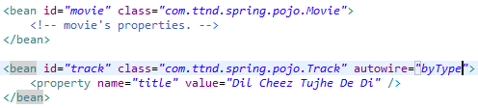
Auto-wiring by type
Auto-wiring using byType works in a similar way to byName, except that instead of considering a property’s name, the property’s type is examined.
When attempting to auto-wire a property by type, Spring will look for beans whose type is assignable to the property’s type.
Only one bean is allowed to be configured that matches the auto-wired property. If more than one beans are found by Spring, an exception would be thrown.

Slide 32
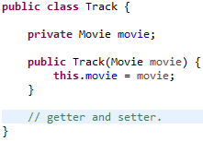

Constructor auto-wiring
If your bean is configured using constructor injection, you may choose to put away the <constructor-arg> elements and let Spring automatically choose constructor arguments from beans in the Spring context.
In this new declaration of duke, the <constructor-arg> elements are gone and the autowire attribute has been set to constructor.
Auto-wiring by constructor shares the same limitations as byType. That is, Spring will not attempt to guess which bean to auto-wire when it finds multiple beans that match a constructor’s arguments. Thus, in the event of ambiguous beans or constructors, an exception would be thrown.

Slide 33
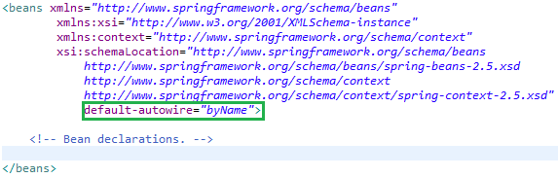
Auto-detect auto-wiring
When a bean has been configured to auto-wire by autodetect, Spring will attempt to auto-wire by constructor first. If a suitable constructor-bean match can’t be found, then Spring will attempt to auto-wire byType.
Default Auto-wiring
By default, beans will not be auto-wired unless you set the autowire attribute.
However, you can set a default auto-wiring for all beans within the Spring context by setting default-autowire on the root <beans> element:

Slide 34
Controlling Bean Creation

Slide 35
Bean Scope
By default, all Spring beans are singletons. That is, when Spring container dispenses a bean, it will always give the exact same instance of that bean.
When declaring a <bean> in Spring, you have the option of declaring a scope for that bean. To force Spring to produce a new bean instance each time one is needed, you should declare the bean’s scope attribute to be prototype.
Most important scopes are:
  singleton (default)
  prototype
  request – scopes a bean definition to an HTTP request. Only used within Spring Web MVC’s web-application context.
  session – scopes a bean definition to an HTTP session. Only used within Spring Web MVC’s web-application context.

Slide 36
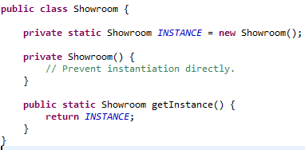
Creating beans from factory methods
Spring instantiates beans generally using public constructors.
What if there is a third-party API exposing some of its types using factory method only, like a Java singleton class. This can be achieved using factory-method attribute of <bean> element.

Slide 37
Advanced Bean Wiring

Slide 38
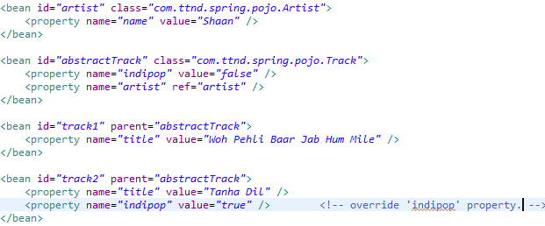
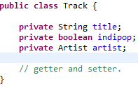

Abstracting Beans
The abstract attribute of <bean> element can be used to create an abstract bean. This tells Spring not to instantiate the bean.
Behaves same like an abstract class in Java.
Serves as a blueprint for other concrete beans. Can be useful to encapsulate common properties shared by the concrete classes.
The parent attribute of <bean> element of concrete beans is used to specify the parent/abstract bean it extends. Concrete beans can override the properties of abstract bean.

Slide 39
Post-processing Beans
Post-processing can be used to alter a bean’s configurations in its life-cycle.
The BeanPostProcessor interface gives you two opportunities to alter a bean after it has been created and wired:
  public interface BeanPostProcessor {
  Object postProcessBeforeInitialization(
  Object bean, String name) throws BeansException;
  Object postProcessAfterInitialization(
  Object bean, String name) throws BeansException;
  }
The postProcessBeforeInitialization() method is called immediately prior to beans’ initialization, i.e., before the call to afterPropertiesSet() method and the bean’s custom init-method configured.
The postProcessAfterInitialization() method is called immediately after the beans’ initialization.

Slide 40
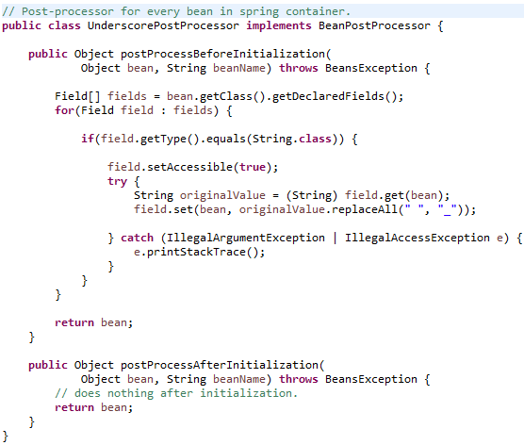
Post-processing Beans example
An example could be to replace the white-spaces of all String properties with underscores:

Slide 41
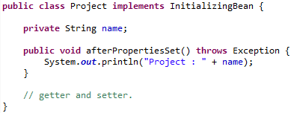
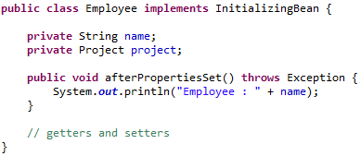
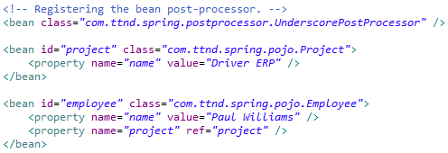
Post-processing Beans example (contd.)
Output
Project : Driver_ERP
Employee : Paul_Williams

Slide 42

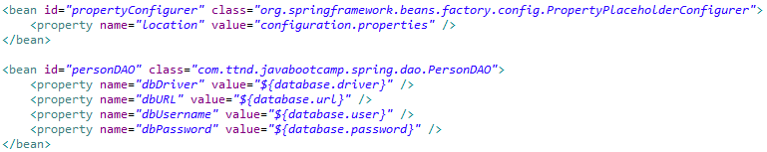
Externalizing Configuration Properties
Putting configuration information is not appropriate in the bean-wiring file. For example, database configurations are a part of deployment detail.
That’s not to say you cannot configure application components within the bean-wiring file. But, this file is mainly oriented towards defining how beans within your application are put together.
Spring’s ApplicationContext provides PropertyPlaceHolderConfigurer to load certain configurations from an external properties file.

Slide 43
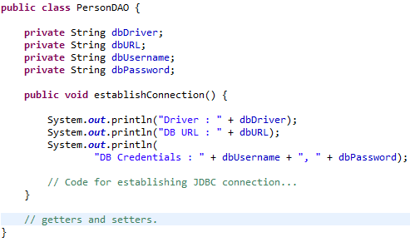
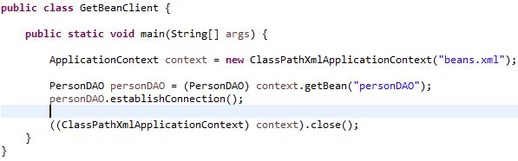
Externalizing Configuration Properties (contd.)

Slide 44
Resolving Text Messages
Certain text that will be available to the end-users of the application shouldn’t be hard-coded:
  The text is subjected to change, involving changes in every other place where it is used.
  Your application will be internationalized, and you will display text in the user’s native language.
There should always be a default message file, along with optional language-specific message files. For example, if the name of your application’s message bundle is “configuration”, you may have the following set of message property files:
  configuration.properties - Default messages when a locale (geographic location) cannot be determined, or when a locale-specific properties file is not available.
  configuration_en_US.properties - Text for English-speaking users in the United States.
  configuration_de_DE.properties - Text for German-speaking users in Germany,…. and so on.

Slide 45


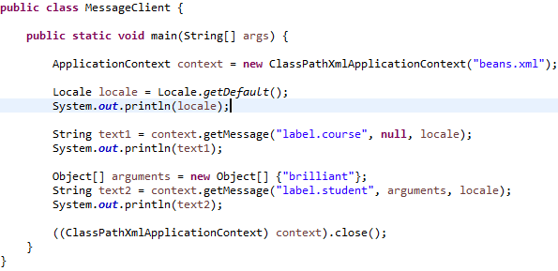
Resolving Text Messages (contd.)
Spring’s ApplicationContext supports parameterized messages by making them available to the container through the MessageSource interface.
Spring comes with a ready-to-use implementation: ResourceBundleMessageSource.

Slide 46
Thank you!
Questions??

